Slide 1
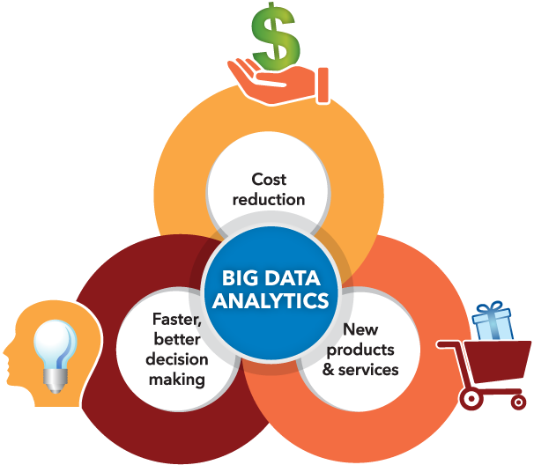
Big Data Analytics
Big Data Analytics is extremely popular amongst companies as it boasts many advantages to becoming a successful business. Cost reduction, efficiency and advancements in products and services are just a few of the advantages that will be discussed as well as how companies acquire this data.

